Slide 1
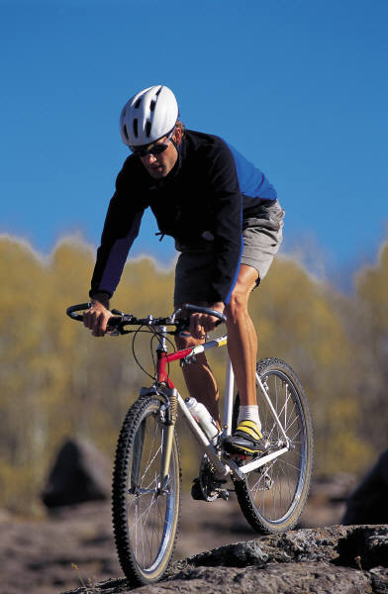
Readers choose books that are just right
Readers use strategies to tell if a book is just right. It is important to know when a book is too hard.
Reading is like bike riding – it should be smooth and fun.
If a hill is too hard to climb when we are riding a bike, we don’t enjoy riding.

Slide 2
Readers choose books carefully
Readers choose books that are just right.
There are many books in our library that are just right.
It makes sense to read a book that feels good to you.

Slide 3
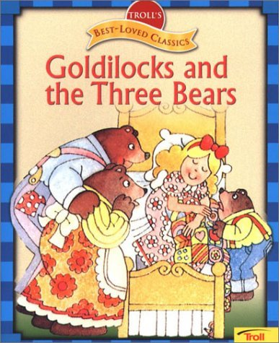
Choosing a just right book
Look at the cover of the book.
Read the title and the author.
Do a picture walk.
Read the first two pages and count how many words are tricky.
0 – 1 Finger Too Easy
2 – 3 Fingers Just Right
4 – 5 Fingers Too Hard

Slide 4
Readers use the class library
Readers understand how to borrow books for their book bin.
Readers respect and take care of our library and the books in our classroom.
Readers return books to school each day.

Slide 5
Reading is Thinking
Thinking about what you already know if called using your schema.
Good readers use their schema to understand the text.

Slide 6
Readers make a plan
Readers make a plan for reading.
In our class, we will read for 15 – 20 minutes every night.
What is your favorite place to read at home?
Who will you read with?
What type of books will you read?

Slide 7
Three Ways to Read a Book
Read the pictures
Read the words
Retell the story

Slide 8
Read to Self
Read the whole time.
Stay in one reading spot.
Read just right books.
Respect the readers around you.
Stop when the book does not make sense.
Read quietly.

Slide 9
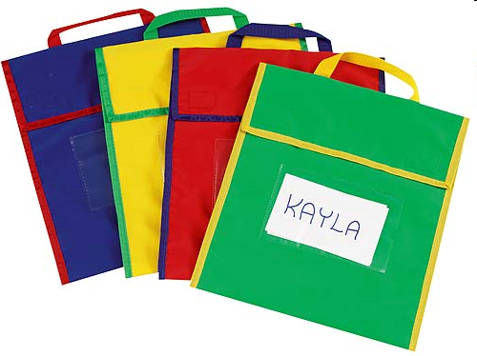
Readers use the class library
Readers understand how to borrow books for their book bin.
Readers respect and take care of our library and the books in our classroom.
Readers return books to school each day.

Slide 10
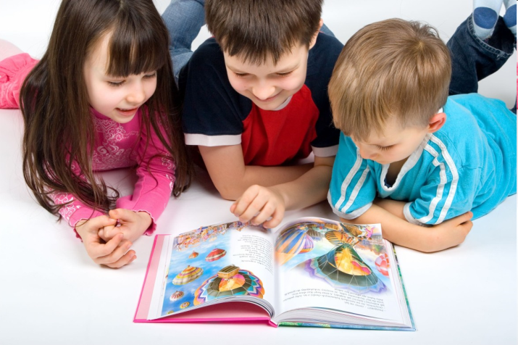
Readers know what to do when they finish a book
Read a new book.
Reread the book.
Retell it to a partner.
Respond to the story in writing.

Slide 11
Readers solve problems
Readers don’t interrupt conferences.
If I have trouble reading, I can:
Use reading strategies to figure out the word.
Ask a friend for help.
Read a different book

Slide 12
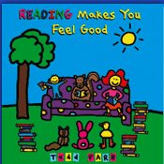
Readers stay focused to increase stamina
Readers think and talk about books with other people.
Reading partners sit elbow to elbow and knee to knee (eekk)
Reading partners make a plan. Taking turns with each page, reading an entire book or echo reading.

Slide 13
Readers talk about books
Reading partners talk about books with each other.
Readers share their favorite part.
Readers ask each other questions.
They talk about their likes and dislikes.
Readers make connections with books.

Slide 14
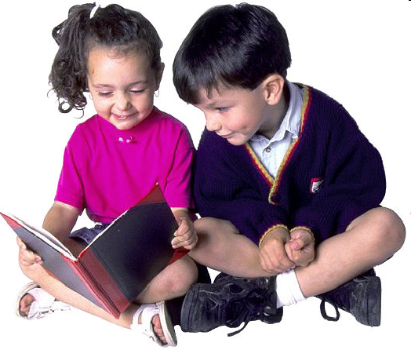
Read to a Friend
Get started right away.
Read the whole time
Stay in one reading spot.
Sit elbow to elbow and knee to knee.
Use a soft voice.

